Slide 1
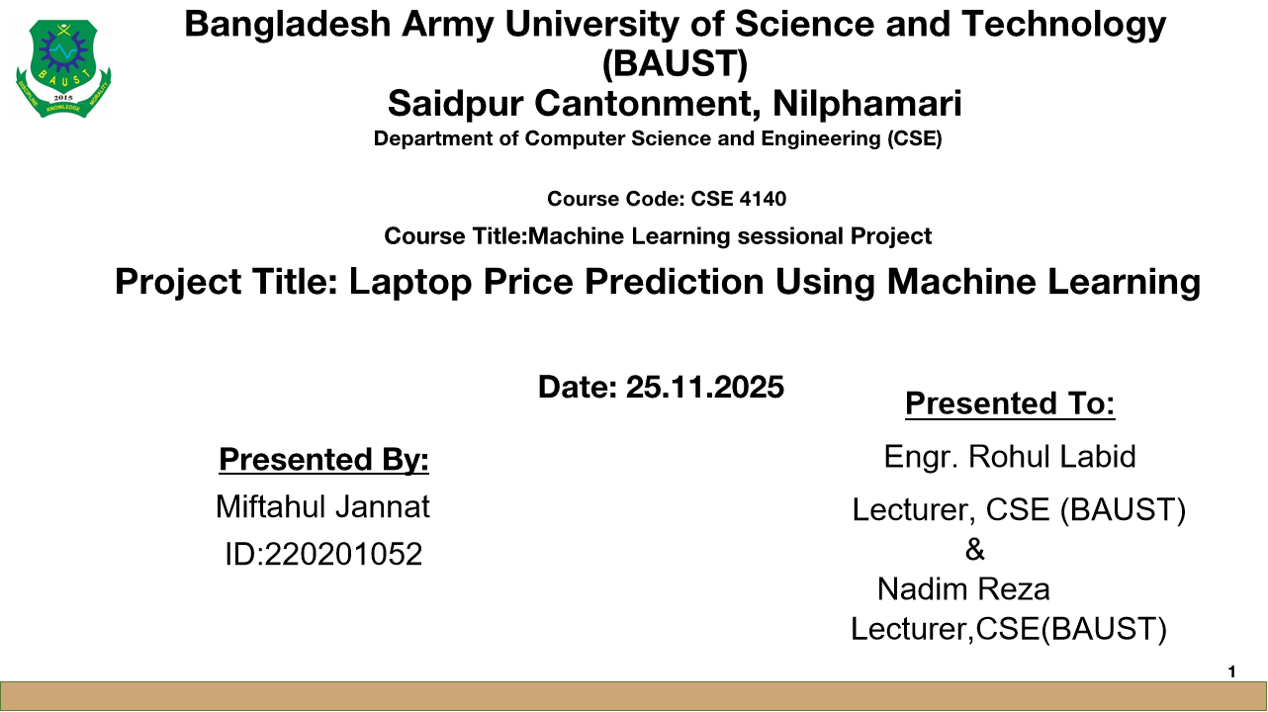


Slide 2
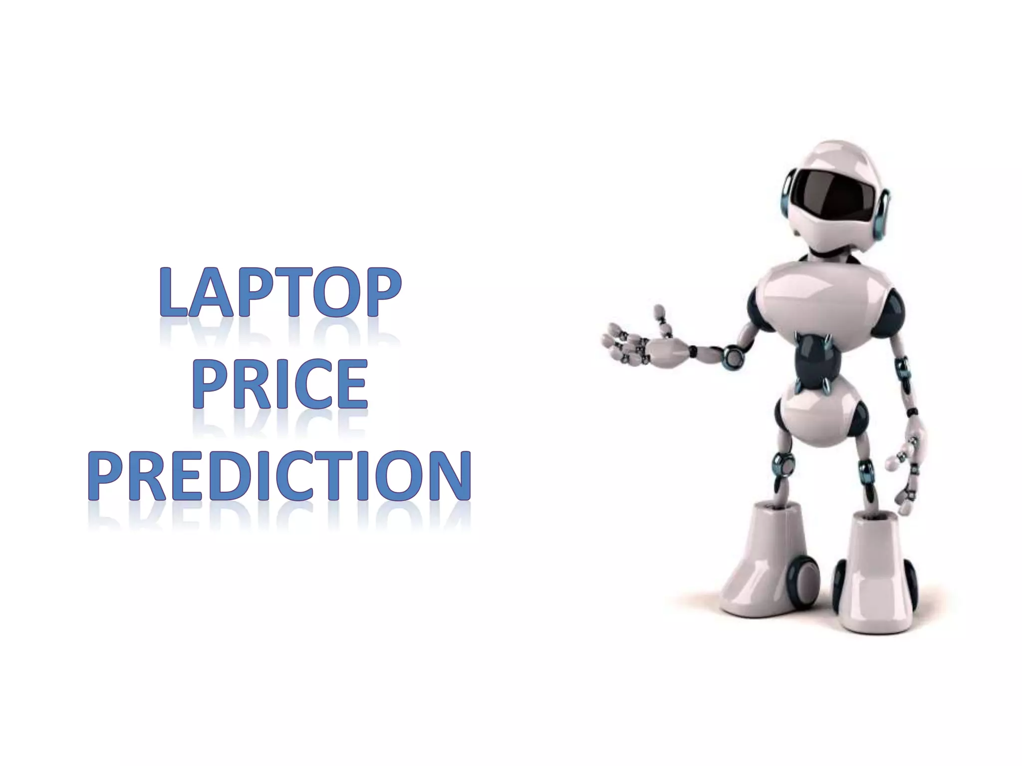
Introduction
Laptop prices vary widely based on configuration and brand.
Manual comparison is time-consuming and inconsistent.
Goal: Build a machine learning model to predict laptop prices reliably.

Slide 3
Objectives
Analyze features affecting laptop price
Build an ML model for prediction
Compare ML algorithms
Provide a tool for buyers/sellers

Slide 4
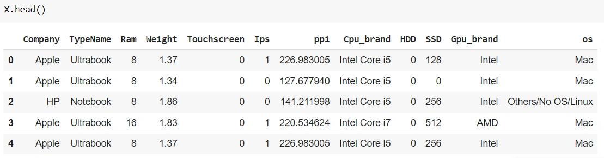
Dataset Description
Total ~1,300 laptop records
Features include:
Brand
RAM
Processor (i5/i7/Ryzen)
Storage (HDD/SSD)
GPU
Display size, resolution
Weight
Battery life
Target variable: Price (BDT/USD)

Slide 5
Data Preprocessing
Handling missing values
Converting categorical → numerical
  Brand → Label Encoding
  Processor/GPU → One-hot encoding
Feature scaling (MinMax / StandardScaler)
Outlier removal using IQR

Slide 6
Exploratory Data Analysis (EDA)
Distribution of laptop prices
Correlation heatma
RAM vs. Price scatter plot
SSD vs. HDD influence on price
Findings:
SSD laptops are generally more expensive
Higher resolution & GPU increase price significantly

Slide 7
Feature Engineering
Creating new features:
Price per GB
Total storage = SSD + HDD
Processor generation extraction
PPI (pixels per inch) from resolution

Slide 8
ML Models Used
Linear Regression
Random Forest Regressor
XGBoost Regressor
Gradient Boosting
K-Nearest Neighbors (KNN)

Slide 9
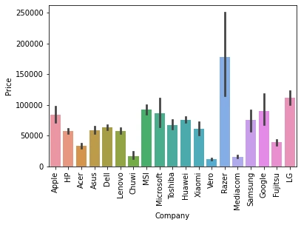
Laptop Prize range Brand wise

Slide 10
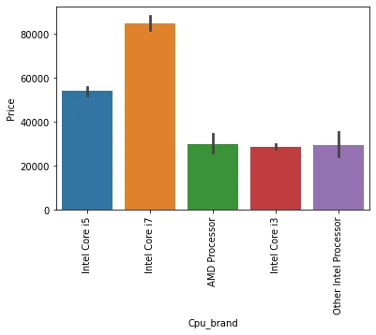
Laptop Processor

Slide 11
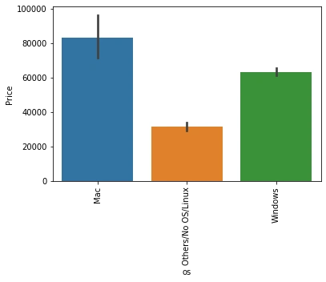
Laptop Operating system

Slide 12
Model Training & Evaluation
Metrics used:
MAE (Mean Absolute Error)
MSE (Mean Squared Error)
RMSE
R² Score

Slide 13
Results
Best Model: ✔ Random Forest
Model | RMSE | R²
Linear Regression | High error | 0.62
Random Forest | Low error | 0.92
XGBoost | Lowest error | 0.91

Slide 14
Final Model Insights
RAM, processor type, GPU, and SSD storage most strongly affect price
Display quality also significant
Brand has medium but notable impact

Slide 15
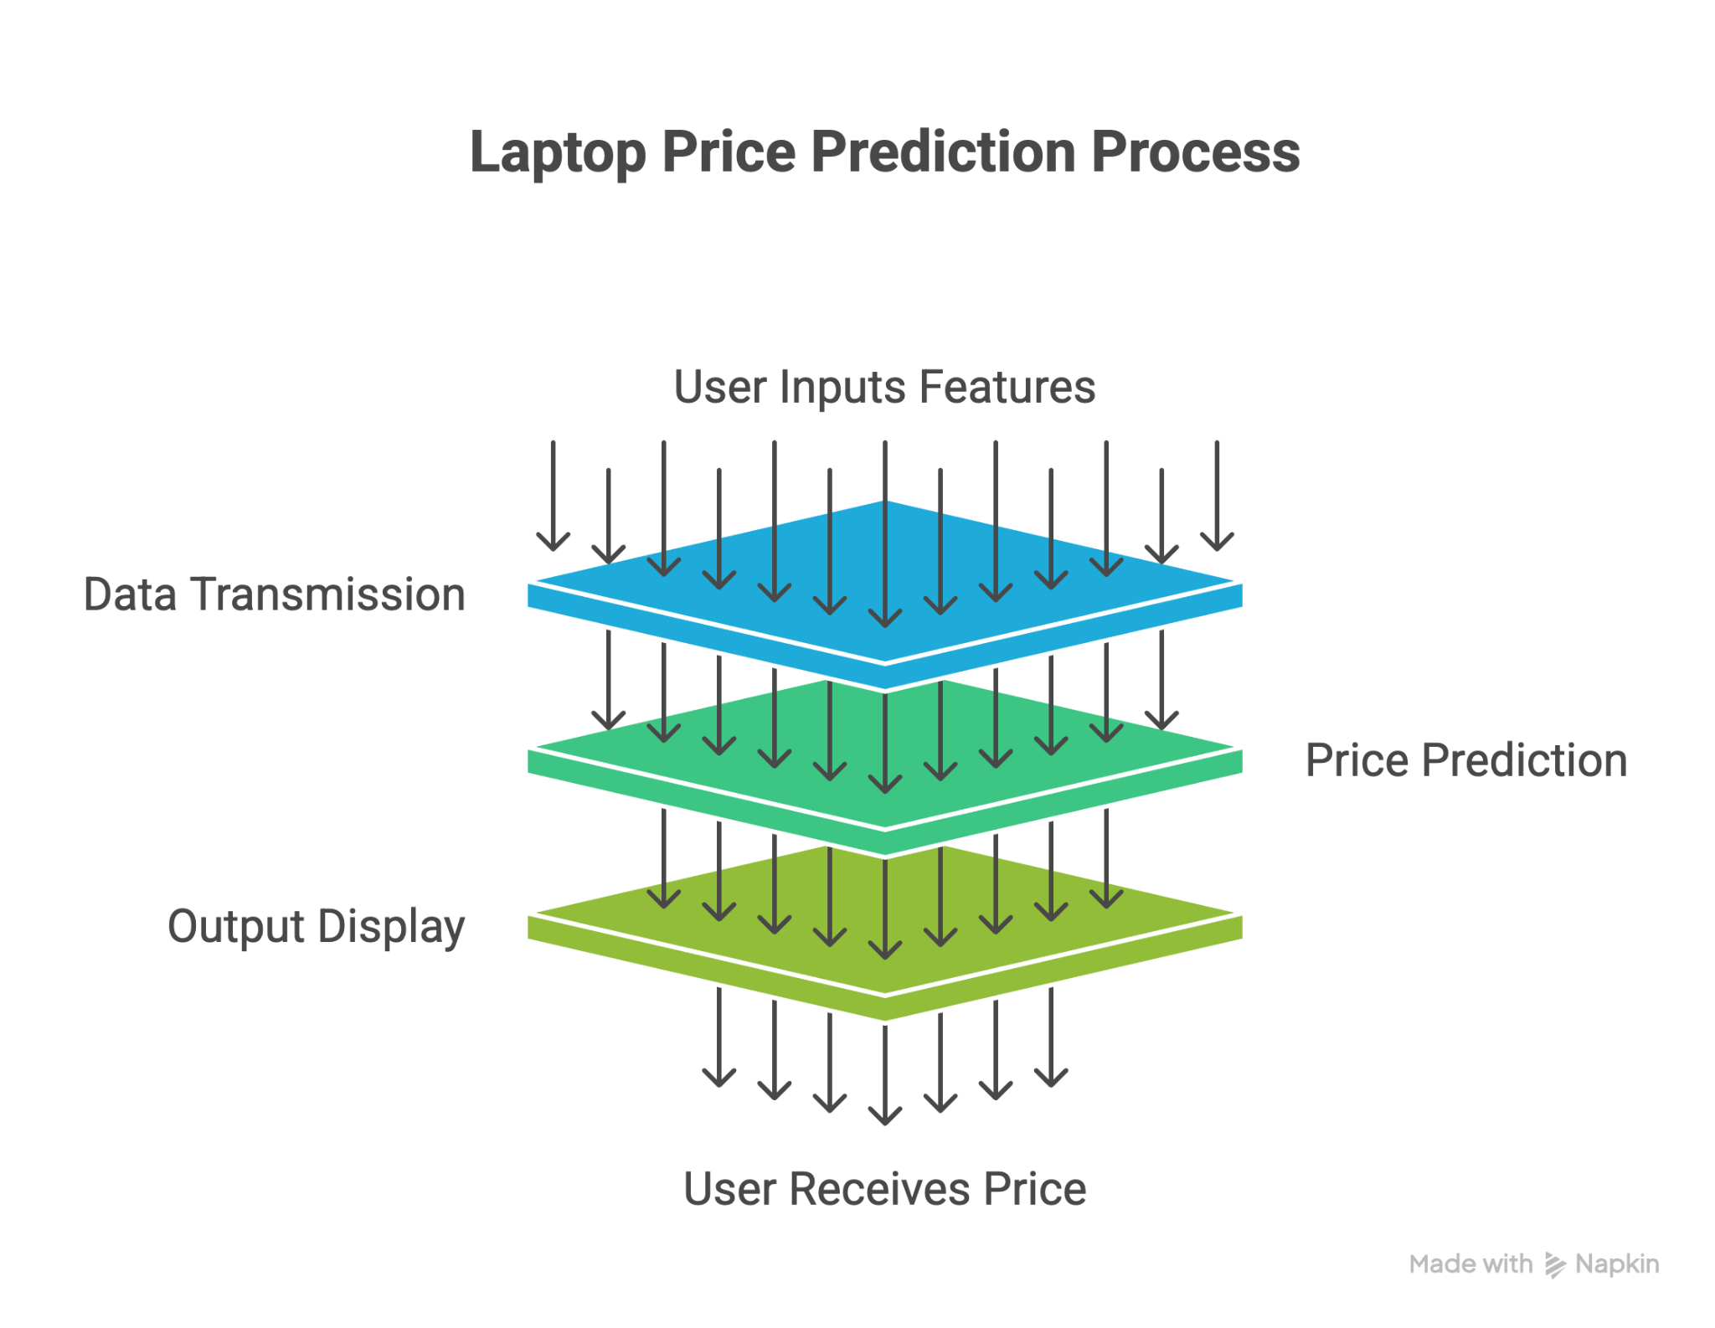
System Workflow Diagram

Slide 16
Conclusion
Machine learning can accurately predict laptop prices
Helps buyers compare value
Useful for sellers, e-commerce, and refurbishing shops
XGBoost model performed the best

Slide 17
References
Surjuse, V., Lohakare, S., Barapatre, A. and Chapke, A., 2022. Laptop price prediction using machine learning. International Journal of Computer Science and Mobile Computing, 11(1), pp.164-168.
Pandey M, Sharma VK. A Random forest algorithm pertaining to the student performance analysis and prediction.International Journal of Computer Applications. 2013 Jan 1;61(13)
Noor, K., & Jan, S. (2017). Vehicle Price Prediction System using Machine Learning Techniques. International Journal of Computer Applications, 167(9), 27-31..
Shaik, Mohammed & Varshith, Medicherla & SriVyshnavi, Sanka & Sanjana, Nagamalla & Sujith, Rama. (2022). Laptop Price Prediction
ﬁAsante, Daniel & Tetteh, Mark & Turkson, Regina & Agyei, Lucy & Asare, Obadiah. (2024). Predicting Electricity Market Price Using Machine Learning and Quantifying Dependency Beyond Renewable Energy. 1-6. 10.1109/i-COSTE63786.2024.11024934.

